Slide 1
Javascript and jquery
Document Object Model
JavaScript examples
jQuery examples
V. Starkey
Computer Science & Engineering
Wright State University

Slide 2
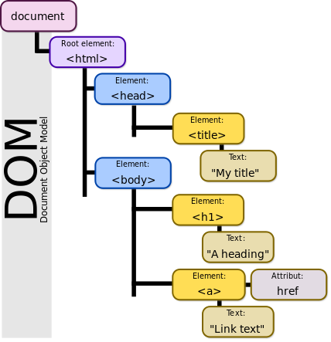
Document object model
The Document Object Model represents the structure of an HTML document and provides a way to navigate through and interact with the objects in that document.
Notes:
Image obtained from Wikimedia Commons, https://commons.wikimedia.org/wiki/File:DOM-model.svg; author: Birger Eriksson

Slide 3
Javascript and jquery
JavaScript - a programing language used to interact with the DOM.
jQuery - a JavaScript library. Using jQuery simplifies code writing and helps ensure that your scripts are well written.

Slide 4
Javascript notes
Dynamic typing – the type is determined during execution
var myVariable = ‘apple';
myVariable = 53;
Use === for testing equality and !== for testsing inequality. This ensures that the comparison will be true only for values that are the same type and the same value.
Functions do not need to state parameter types or return types:
function multiply(num1,num2) {
var result = num1 * num2;
return result;
}

Slide 5
events
Events may be attached to an element directly by using a selector; element and attribute references may be stored in variables:
document.querySelector(‘h1’).onclick = function() {
//code here
};
var myImage = document.querySelector(‘img’);
myImage.onclick = function() {
var mySrc = myImage.getAttribute(‘src’);
//additional code here
};

Slide 6
Local storage
HTML5 provides two objects for storing data on the client side:
localStorage – persists between sessions (but is deleted when browser history is cleared).
use localStorage.setItem(keyName, keyValue) to store and localStorage.getItem(keyName) to retrieve. keyName and keyValue are strings.
sessionStorage – data is lost when the browser tab is closed
A good explanation of how local storage works may be found at http://www.sitepoint.com/html5-local-storage-revisited/
A thorough discussion of the WebStorage API may be found at http://www.w3.org/TR/webstorage/

Slide 7
Additional information
The Mozille Developer Network is a good resource for learning more about JavaScript. An introductory lesson may be found here: https://developer.mozilla.org/en-US/Learn/Getting_started_with_the_web/JavaScript_basics

Slide 8
jQuery
The jquery library needs to be available on your local computer or through a Content Delivery Network
<script src=“jquery-2.1.3.js”></script> //if on computer
or
<script src=http://code.jquery.com/jquery-1.11.3.min.js><script>
https://jquery.com/download for files; scroll down to find the file reference from a CDN

Slide 9
Using jQuery
The next slides are provided with the textbook Murach’s HTML5 and CSS3, 3rd edition.
A reference for the jQuery API may be found at https://api.jquery.com/

Slide 15
